Slide 1






PROJECT-I I (CT705-N)
SENTIMENT
ANALYSIS
Recommendation System
GROUP NO : 89

Slide 2




Our Team
PRINCE
KEYUR
MALANI
PATEL
20BEIT30046
20BEIT30077
AARYA
DHWANI
PATEL
DESAI
20BEIT30060
20BEIT30025
Guided By : Prof. Yogesh Vaghela

Slide 3

Outlines
Abstract
Introduction
Scope
Tools & Technology
Advantages
Implementation
Future Scope
Conclusion

Slide 4


Abstract
In the world of the digital commerce as well as OTT platforms there is a need of the recommendation as well as system have to decide which products are needed to the customers based on the sentiments associated with the products.
The project is intended to develop a recommender system for such system and also able to identify the sentiments associated with the products.

Slide 5
Introduction
A recommendation system using sentiment analysis harnesses the power of natural language processing and machine learning algorithms to understand users' sentiments and emotions associated with various items or content.
By recognizing positive, negative, or neutral sentiments, the system gains a deeper understanding of users' preferences, making the recommendations more relevant and engaging.

Slide 6




Applications
Streaming Platforms
Travel Recommendations
Food Recommendations
E-Commerce
Sentiment analysis analyzes customer feedback, identifies positive/negative sentiments, and enables the recommendation of relevant products based on positive sentiments.
By analyzing user sentiments and reactions to movies and TV shows, the recommendation system can offer personalized content suggestions based on users' emotions and interests.
By analyzing sentiment from travel reviews and social media posts, the system can recommend destinations, hotels, and activities that align with users' preferences and emotional inclinations.
Sentiment analysis of restaurant reviews and food-related content can help in recommending eateries and dishes that match users' tastes and preferences.

Slide 7







Tools & Technology
Jupyter Notebook
Java
script
CSS
Python
HTML
FLASK

Slide 8




Advantages
Better Discovery of Content
Personalized recommendations can enhance user satisfaction and engagement.
Enhanced User Engagement
Continuous emotional feedback fuels the recommendation system's ongoing improvement, adapting to user preferences, identifying trends, and minimizing biases for relevant and fair recommendations.
Reduced Information Overload
The streamlined decision-making process can enhance the platform's reputation for user-centricity and customer satisfaction.
Continuous Learning and Improvement
The self-learning nature of the system reduces the need for manual adjustments, making it more efficient and scalable.

Slide 9
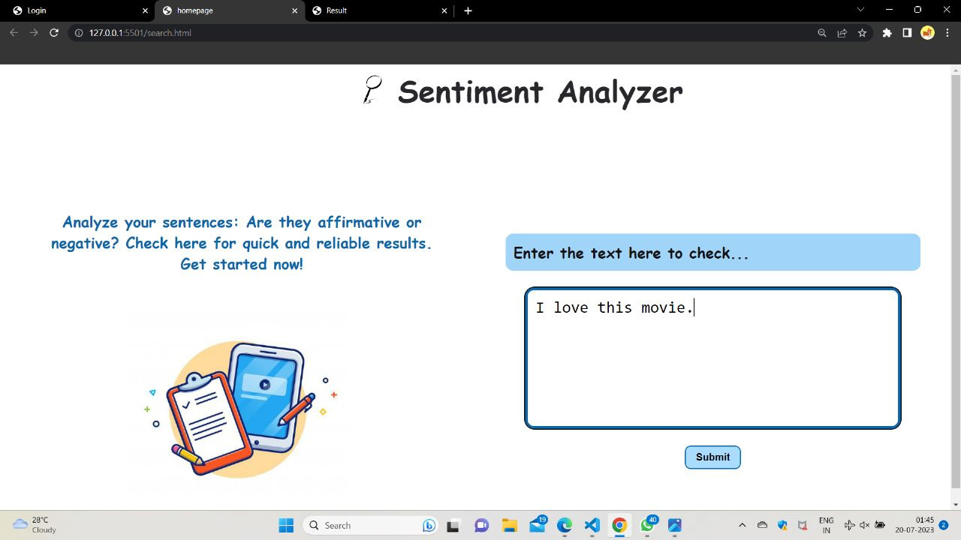

Implementation

Slide 10
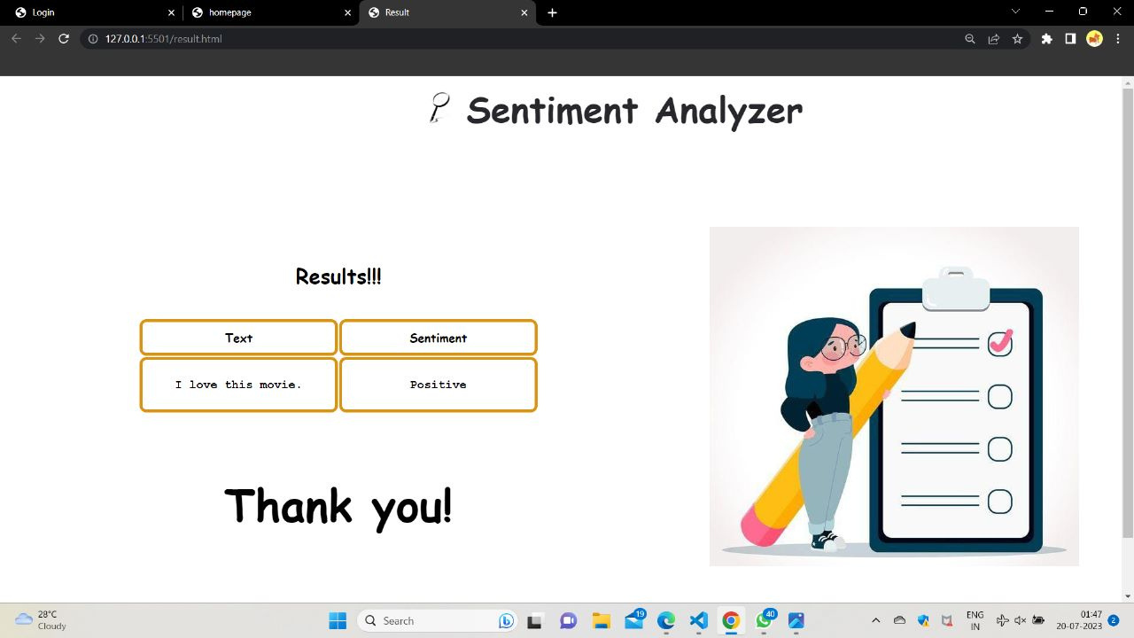
Implementation

Slide 11

Future Scope
Sentiment-aware with Virtual Assistants
Sentiment-enhanced Group Recommendations
Integrating sentiment analysis into chatbots and virtual assistants will enable them to respond more empathetically and offer recommendations that are sensitive to users' emotions.
Sentiment analysis can be extended to make group recommendations, considering the collective emotional preferences of a community or a group of users with similar sentiments.

Slide 12
Conclusion
In conclusion, a recommendation system made using sentiment analysis represents a powerful and evolving approach to enhancing user experiences and engagement across various industries and platforms. By leveraging natural language processing and machine learning techniques to understand users' emotions and sentiments, these systems offer a more personalized and empathetic approach to making recommendations.

Slide 13
THANK YOU

